Slide 1
IDM 250
wk 01

Slide 2
Course Overview
Notes:
In Web Authoring I you designed and coded static html pages. Everything that existed on the page, that you viewed in your browser window, was coded into the html file. With Content Management Systems like WordPress, the main sections of each page is broken into distinct parts (header, content, sidebar, footer), and the actual content is stored in a database. When you request a page in your browser the WordPress system dynamically assembles each page on the fly, grabbing the pieces and content that it needs, and generates the static html that is served to your browser. All of this information regarding style and layout is stored in your Theme folder. Since every page is dynamically driven it is important to have a comprehensive plan before you start coding or even designing.

Slide 3
Objectives
Become familiar with Content Management Systems (CMS) to create Dynamic websites.
Work and understand the difference with both client and server side languages
Notes:
In Web Authoring I you designed and coded static html pages. Everything that existed on the page, that you viewed in your browser window, was coded into the html file. With Content Management Systems like WordPress, the main sections of each page is broken into distinct parts (header, content, sidebar, footer), and the actual content is stored in a database. When you request a page in your browser the WordPress system dynamically assembles each page on the fly, grabbing the pieces and content that it needs, and generates the static html that is served to your browser. All of this information regarding style and layout is stored in your Theme folder. Since every page is dynamically driven it is important to have a comprehensive plan before you start coding or even designing.

Slide 4
Requirements
Knowledge of HTML and CSS
Beginners knowledge of PHP
Self hosted web domain
FTP software (Filezilla, Cyberduck, Fetch..etc)

Slide 5
What is a Content Management System?
A CMS is a collection of files (HTML, CSS, PHP...etc) that generates a website and allows you to edit that website.
It is a collection of web pages that allow you to edit your public web pages.

Slide 6
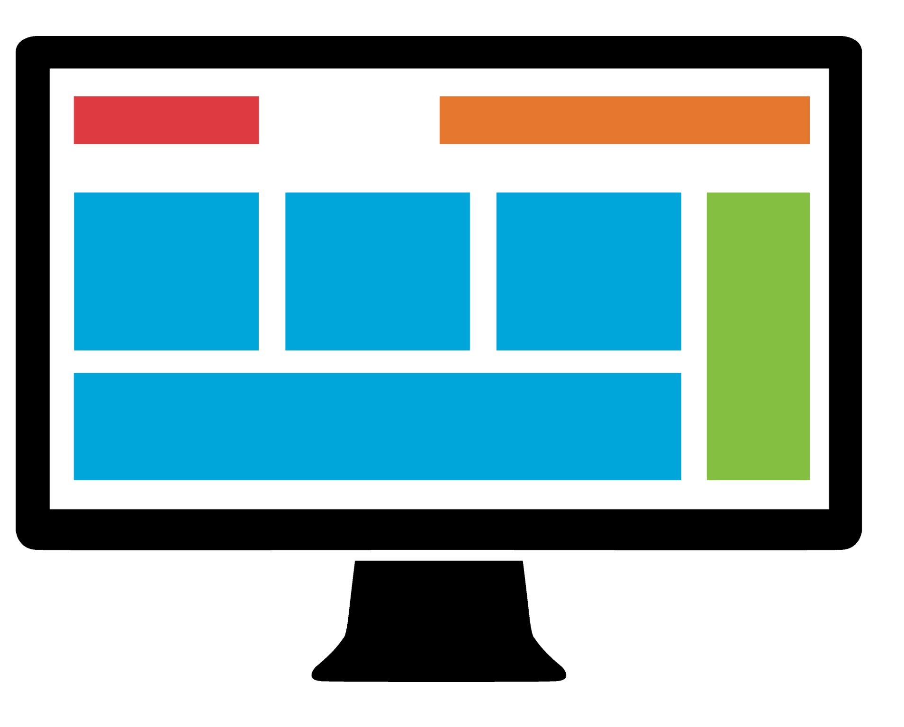
What is a Content Management System?
Static Website
Pages are made of only HTML, CSS, and JS.
These are all consider client-side languages. They can only manipulate what client (the web pages) and what the user sees.
HTML, CSS, JS

Slide 7
What is a Content Management System?
Website Using CMS
Pages are made of HTML, CSS, JS, and a server-side language (like PHP).
A server-side language manipulates the server. This is what the web pages are hosted on.
This server-side language also generates the web pages.

Slide 8

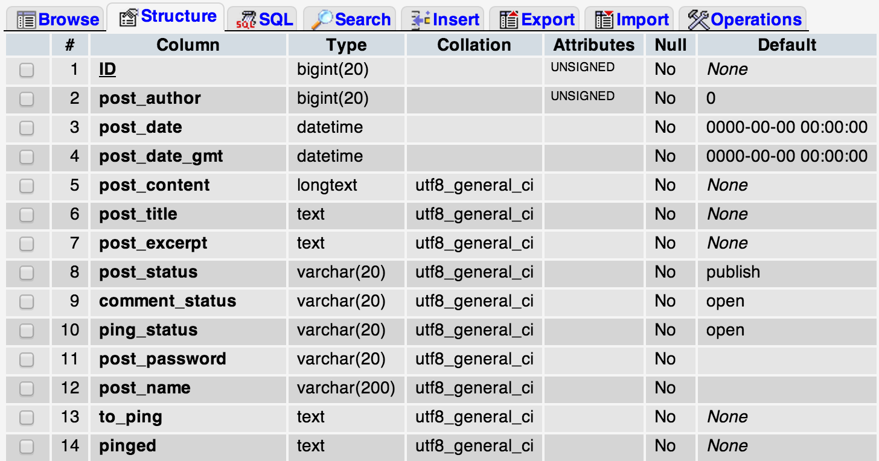
What is a Content Management System?
Holds information for whole site.
EX:
How many blog posts?
Who wrote each?
When were they written?
What is the content of the post?
Database (MySQL)

Slide 9

What is a Content Management System?
EX: Server-side language checks database. Database says 12 blog posts were created. Server-side language generates a page for each post in HTML, CSS, and JS.
Database (MySQL)
Server-side language files
Pull information from database and generate web pages
HTML, CSS, JS

Slide 10

What is a Content Management System?
Instead of editing the information in the database, we use a CMS to update it.
EX: Want to delete a blog post? Delete it in the CMS. It will delete it from the database and the post will no longer be generated.
A CMS is a user-friendly way to manage your database!
CMS
(HTML,CSS,JS, and PHP)
Server-side language edits database
Database (MySQL)
Server-side language files
Pull information from database and generate web pages
HTML, CSS, JS

Slide 11
CMS Examples
WordPress
Joomla
Drupal
Django
ExpressionEngine
Ghost
Craft

Slide 12
Installing WordPress

Slide 13
Installing WordPress
Create database to hold information
Add user to database
Download WP CMS files
Upload WP CMS files to your website
Go through WP install
Login!

Slide 14
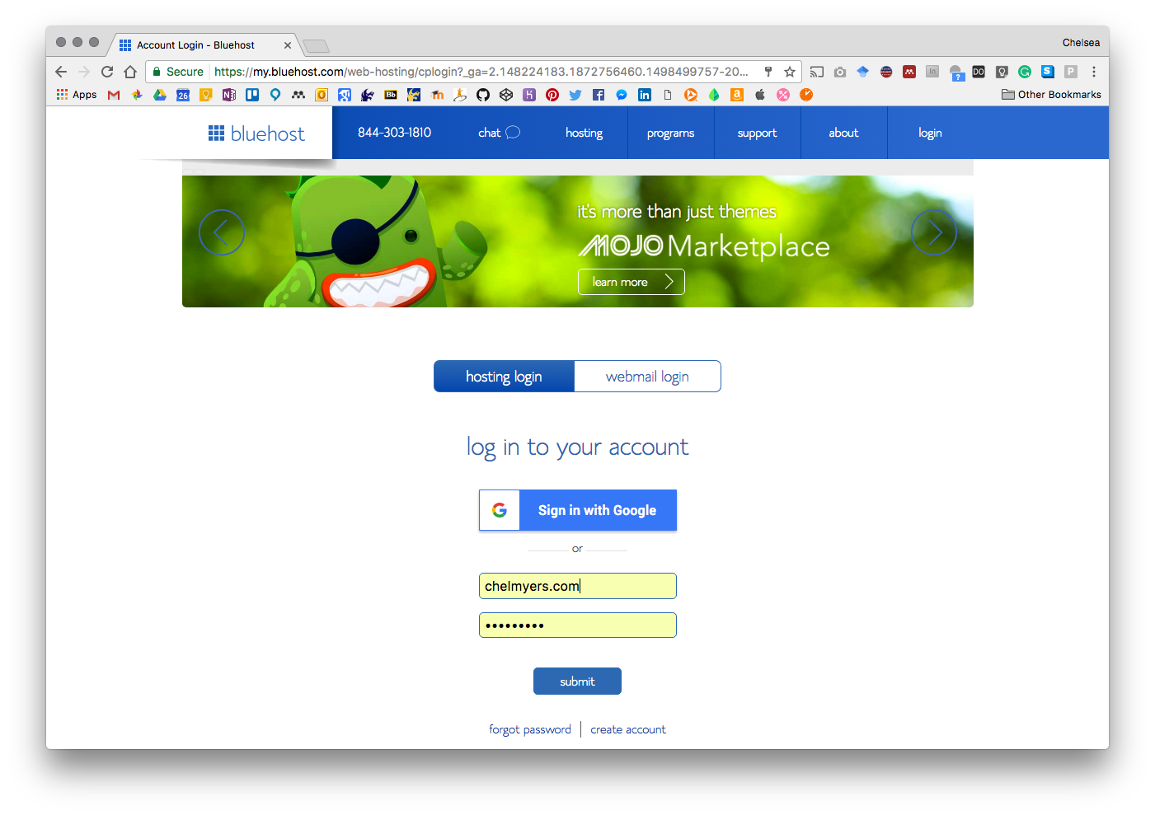
Create Database
Log into web host.

Slide 15
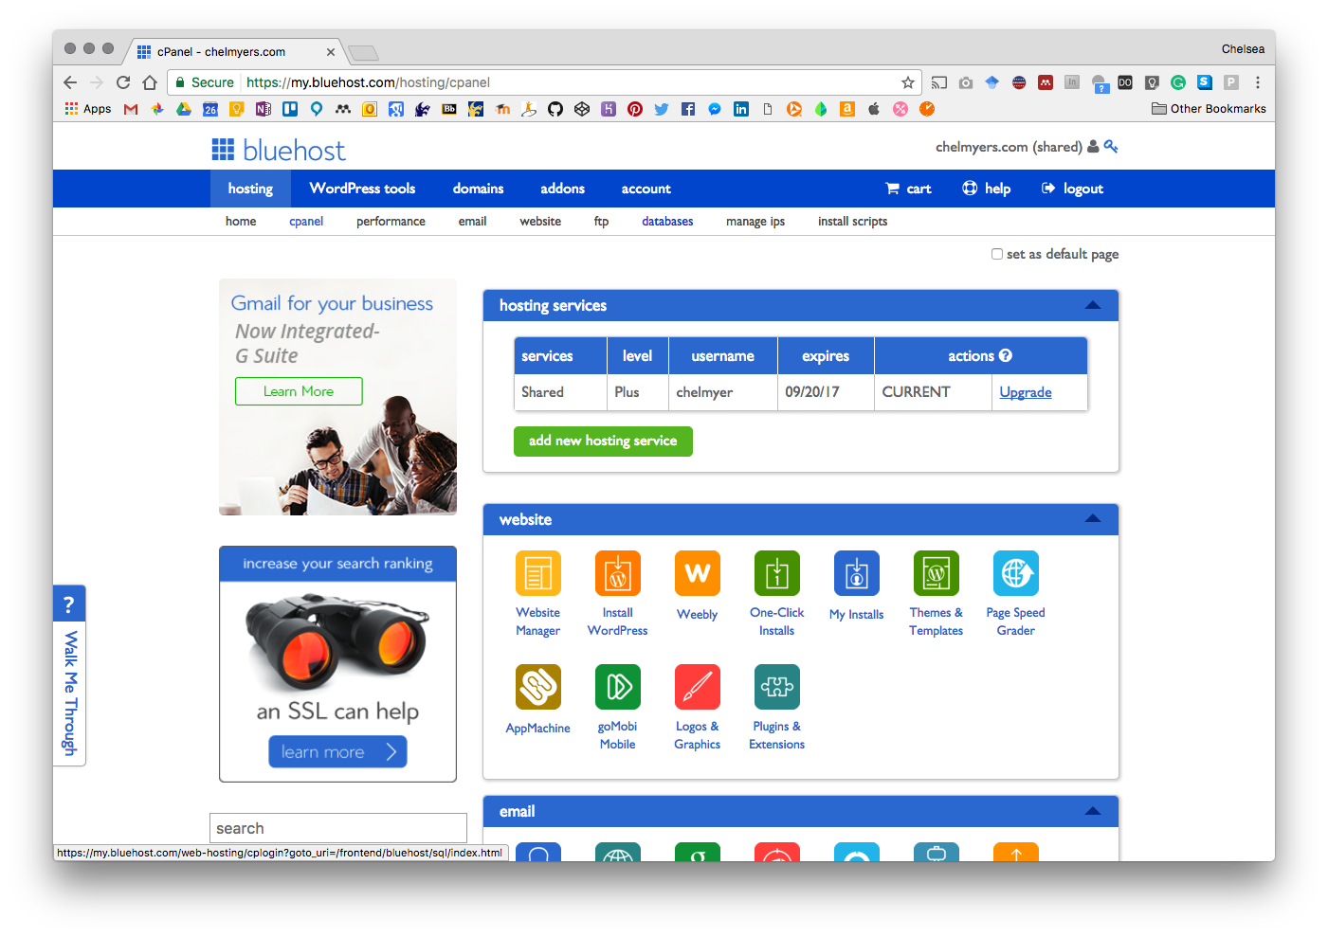
Create Database
Find “Database” page and go to it.

Slide 16
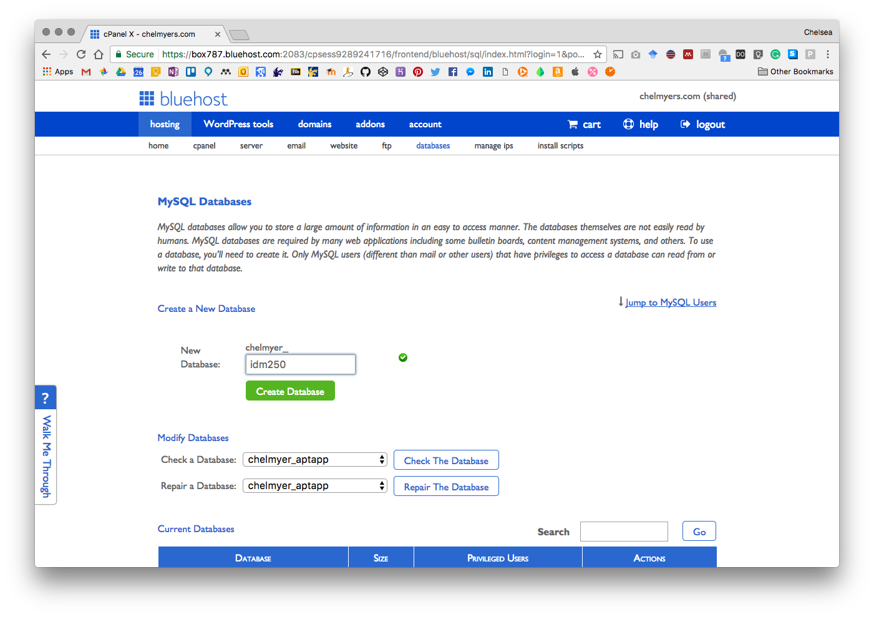
Create Database
Give your database a name and hit “Create Database”.
This database is named “chelmyer_idm250”
Write down your database name!

Slide 17
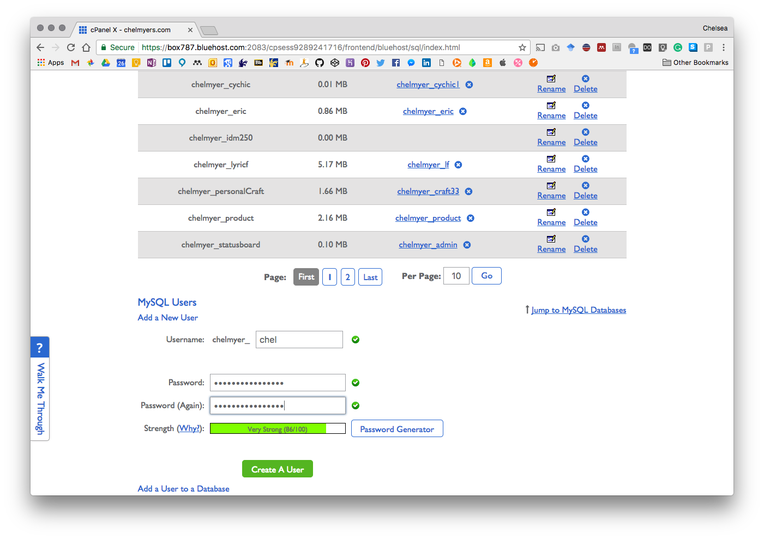
2. Add user to database
Go back to database page and find “MySQL Users” section.
Create a new user (with a unique name) and generate a password for the user.
WRITE BOTH OF THESE DOWN!!!
My username is now “chelmyer_chel” and my password is a secret!
Next, create the user!

Slide 18
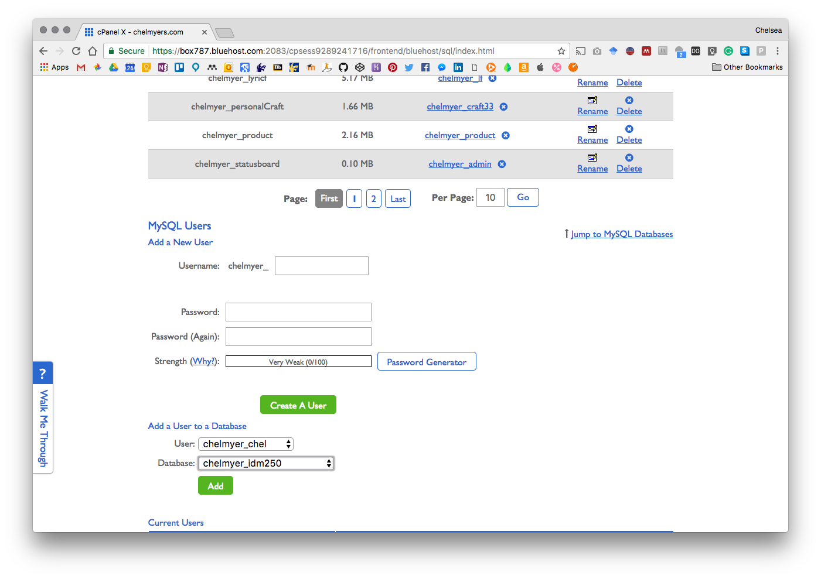
2. Add user to database
Now, allow your new user to access the new database under “Add a User to a Database”
Select your new user for “User:” and new database for “Database:”
Click “Add”

Slide 19
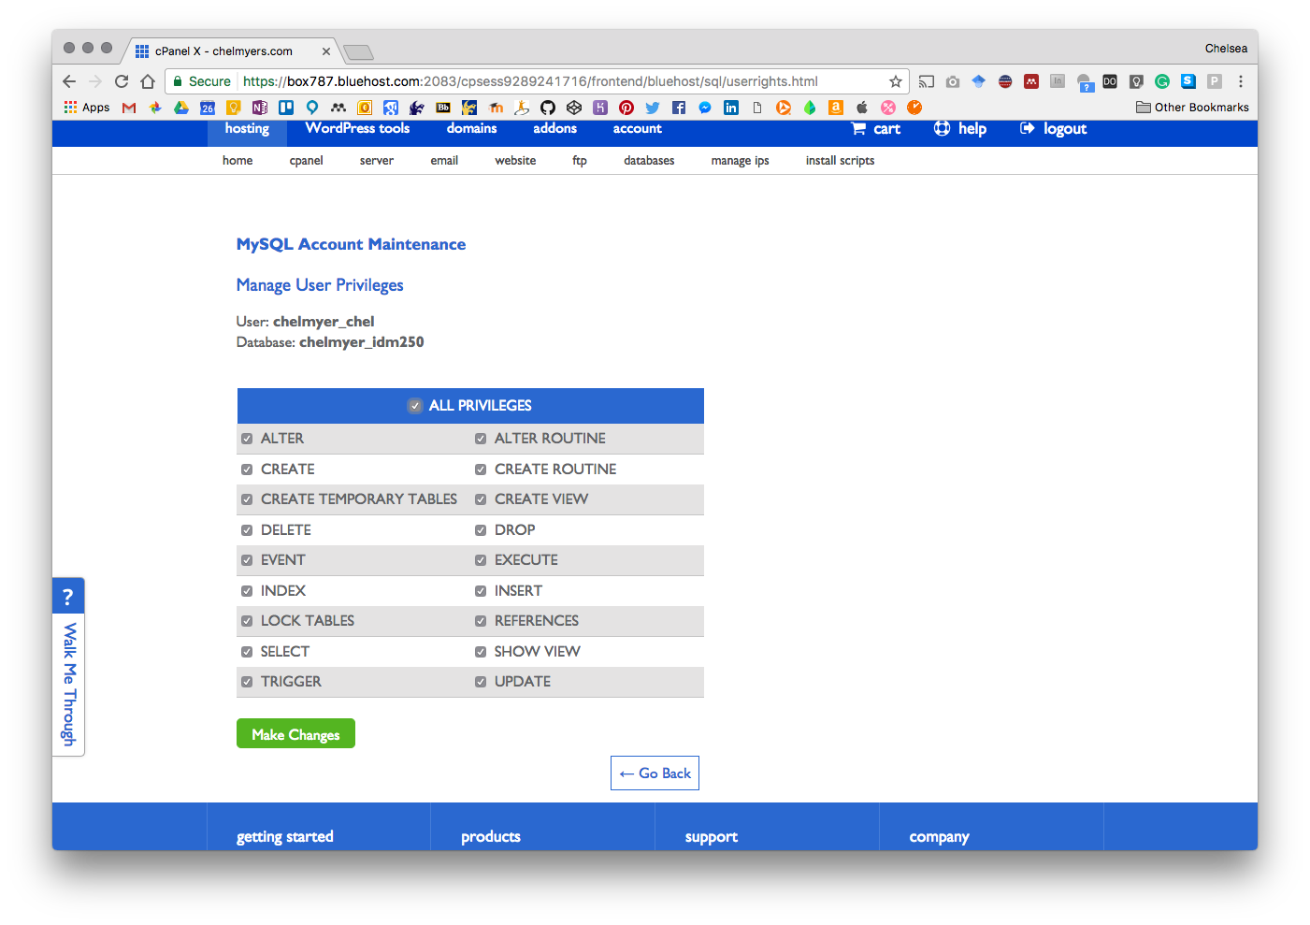
2. Add user to database
GIVE NEW USER ALL PRIVILEGE TO THIS DATABASES!
Check the All Privilege box.
Click “Make Changes”

Slide 20
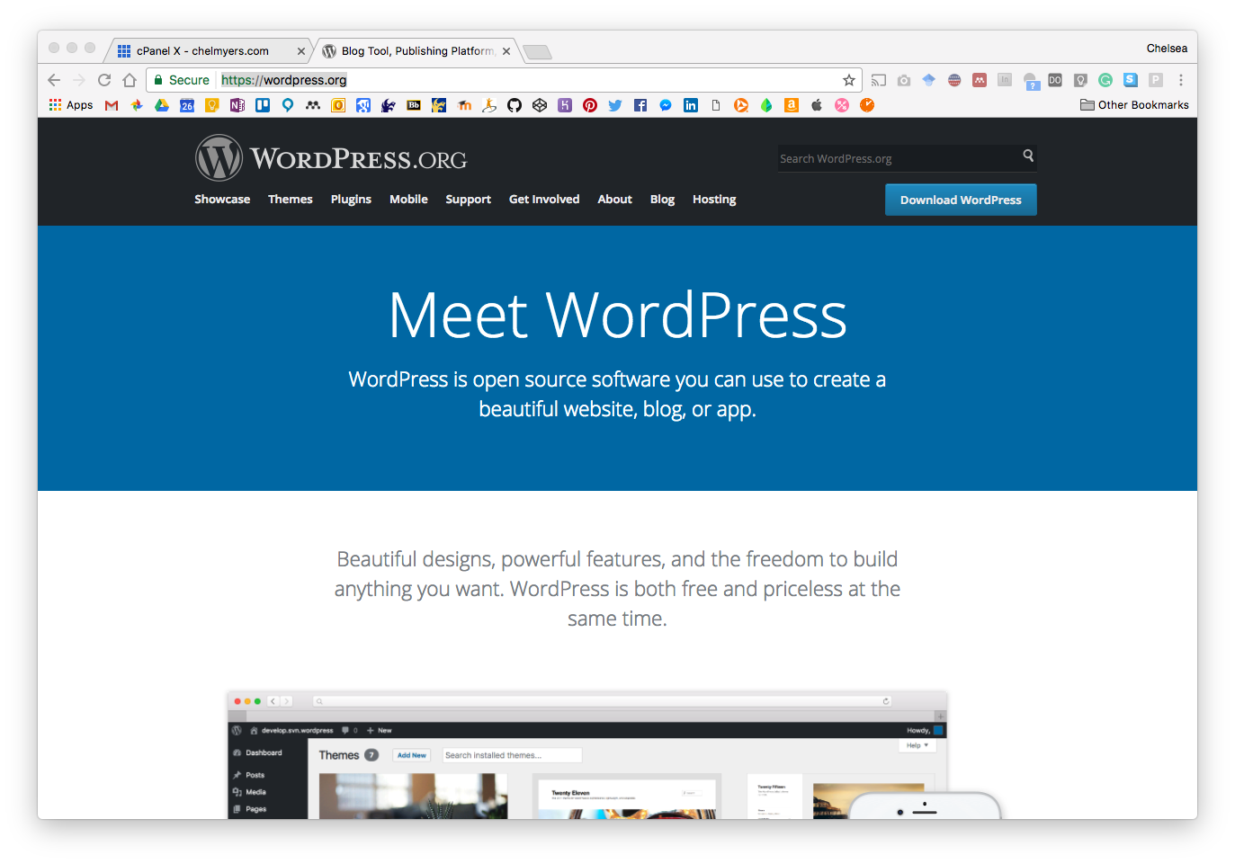
3. Download WP CMS Files
Download WordPress CMS files at:
https://wordpress.org/

Slide 21
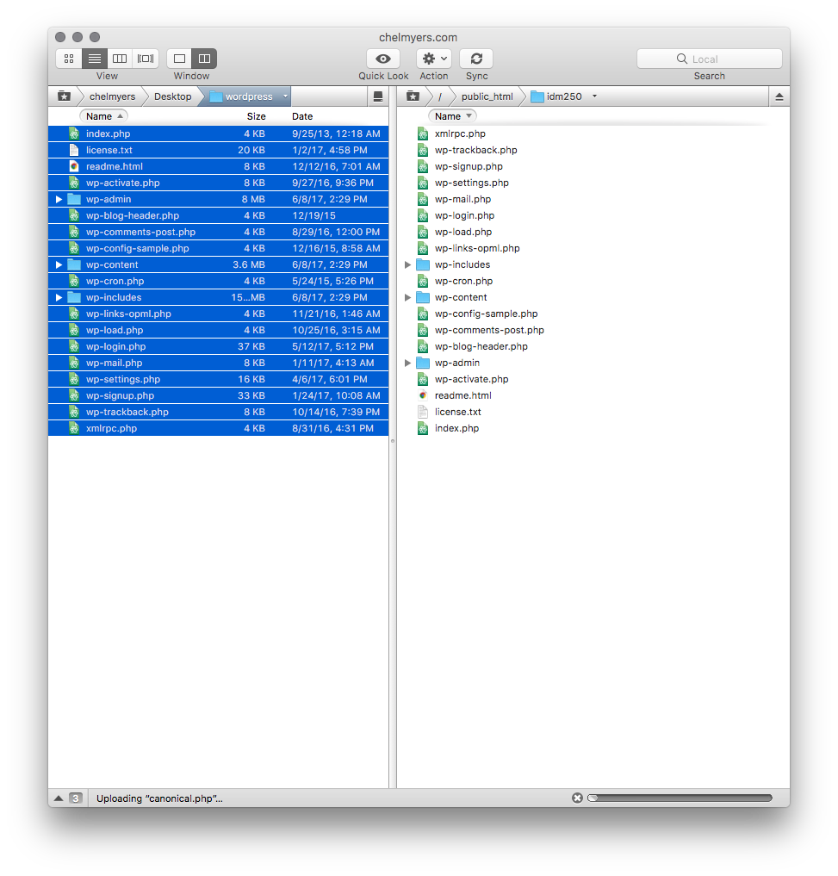
4. Upload WP CMS Files to Site
Unzip WP files.
Use FTP software to log onto your server.
Navigate to “public_html”.
If you want this to be your new site, move old index.html (and other static site files) and upload WP folder contents into main “public_html”. If not, create a new folder (like idm250) and upload files there.
The upload WILL take awhile.

Slide 22
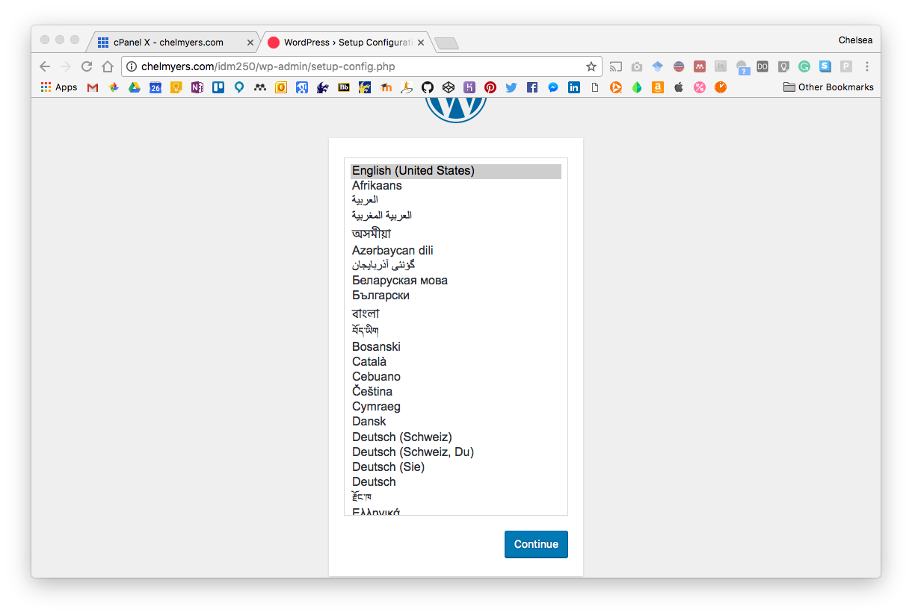
5. WordPress Install
Go to your website or your website.com/newfolder
Since I put my new WordPress files in the folder “idm250” I must visit “chelmyers.com/idm250” to install WordPress in that folder.
Select your language.

Slide 23
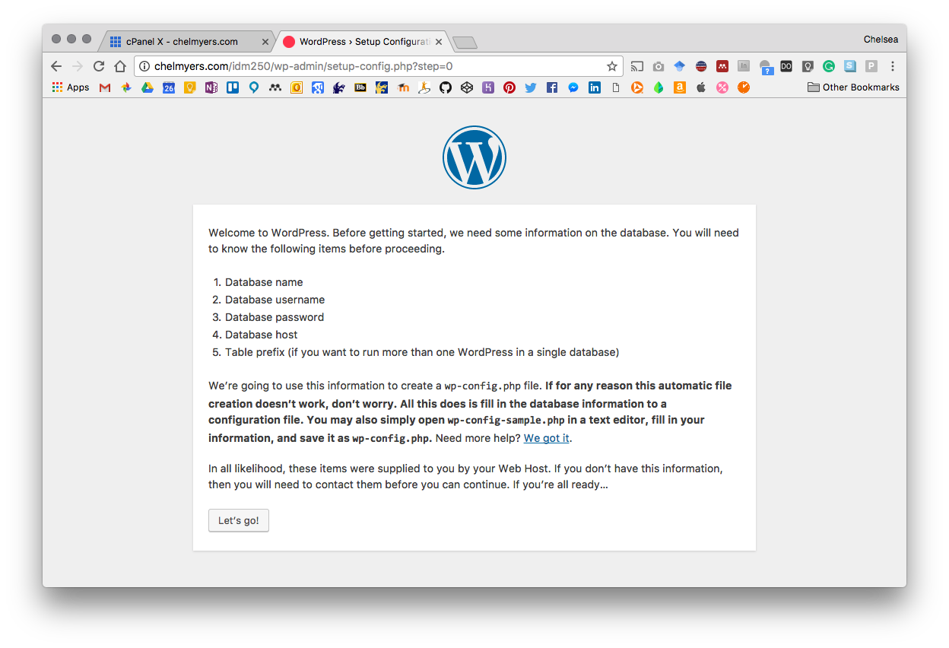
5. WordPress Install
Make sure you have your database name, username, and password!
Click, “Let’s go!”

Slide 24
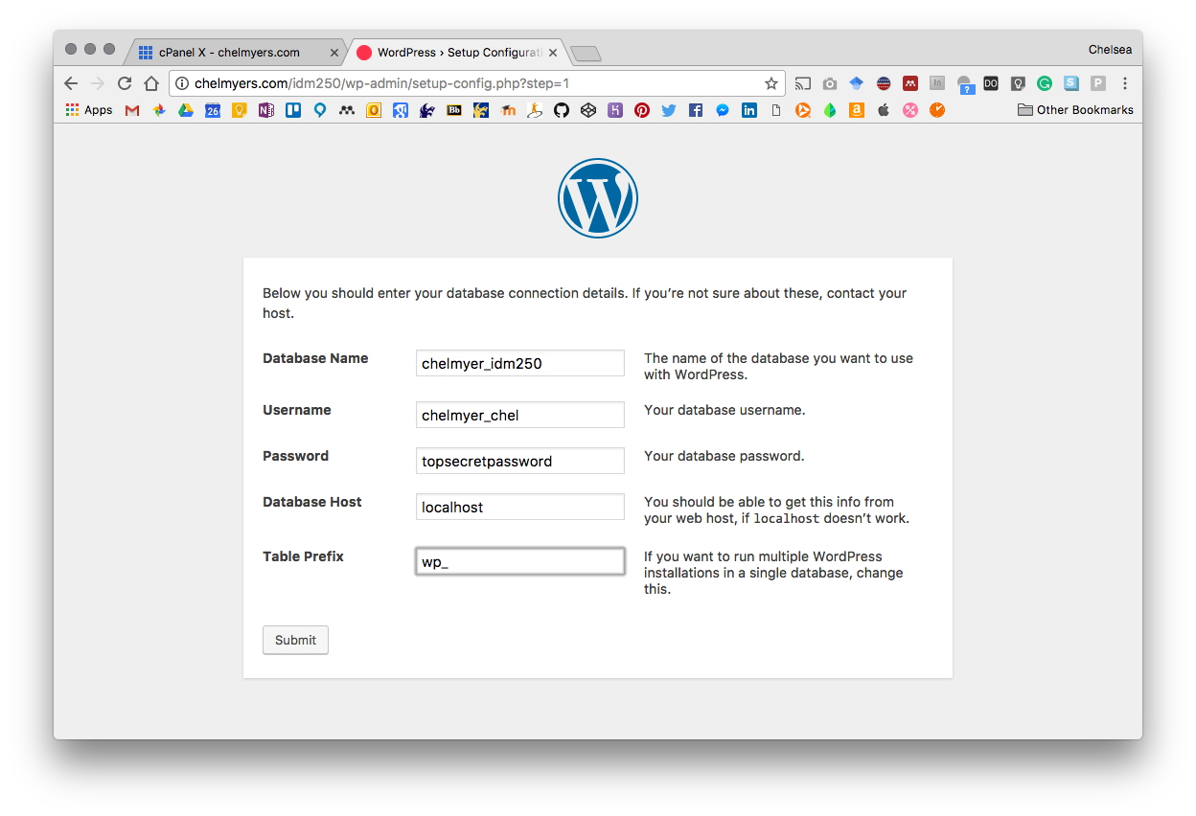
5. WordPress Install
Enter in your information.
Leave Database Host as “localhost” and Table Prefix as “wp_”

Slide 25
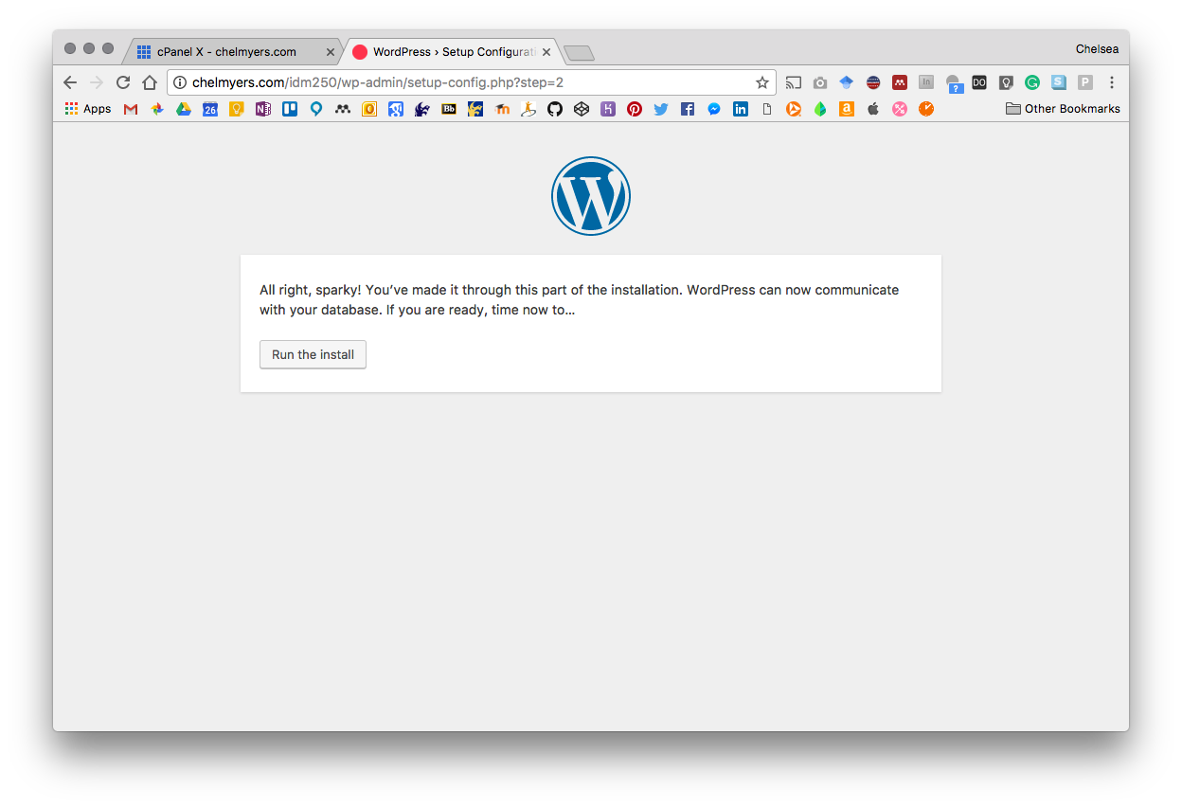
5. WordPress Install
Once connected, run the install.

Slide 26
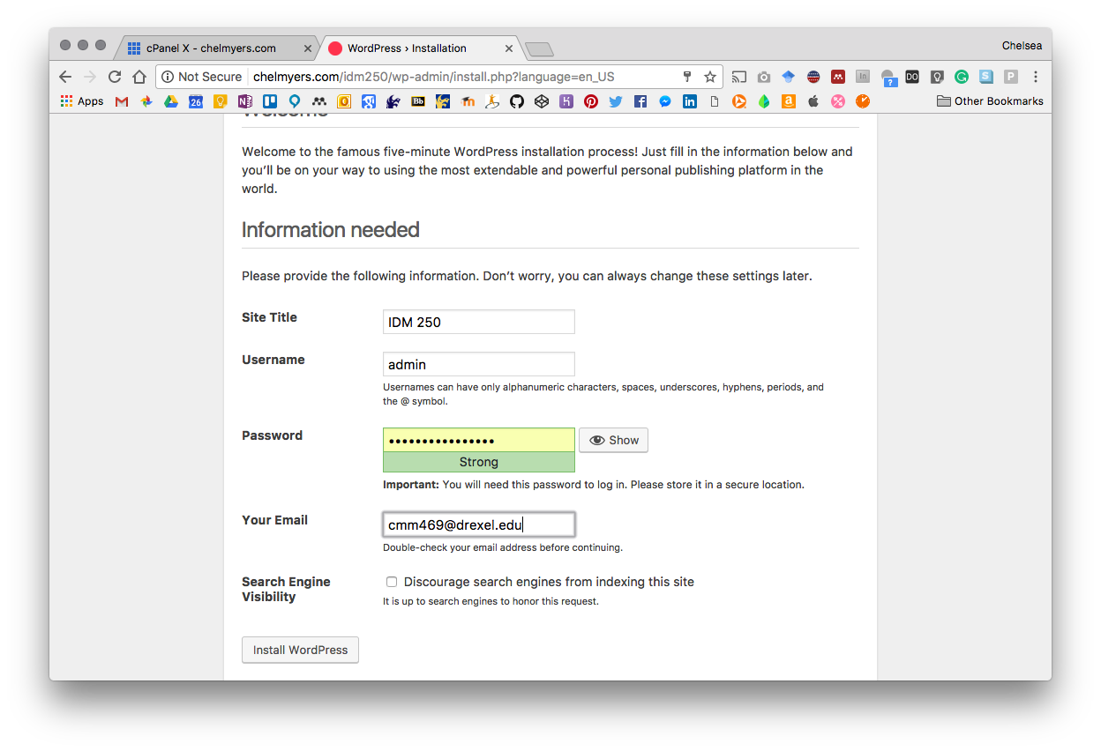
5. WordPress Install
Enter in your site information like:
Site Name
Create your login information (how you will log into your CMS)

Slide 27
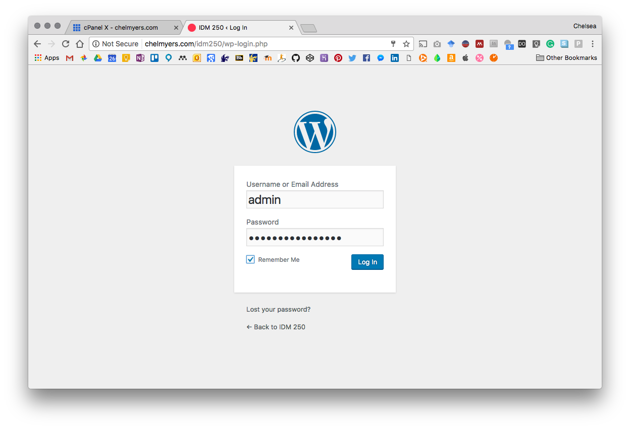
6. Login
Install WordPress and go to your WordPress install url and /wp-login.php. Mine is “chelmyers.com/idm250/wp-login.php”
Login with the information you JUST set!

Slide 28
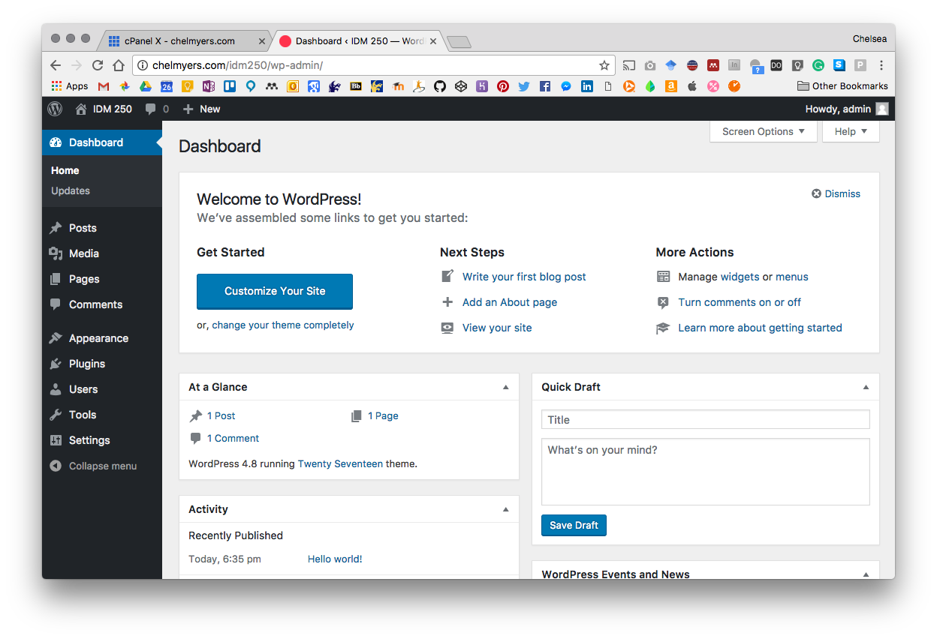
6. Login
Congrats! You installed WordPress!

Slide 29
Themes

Slide 30
Themes
You will create a THEME for your CMS in either one of two ways…
Child Theme of a Pre-made Theme:
Using based “parent” theme but make tweaks with a “child” theme that you create.
https://wordpress.org/themes/
https://themeforest.net/category/wordpress
https://colorlib.com/wp/free-wordpress-themes/
Starters:
Nothing meeting what you want? Create it from “scratch” with a starter theme.
https://themble.com/bones/
http://underscores.me/

Slide 31
Planning your website

Slide 32
Define your goal
What is your professional goal?
How can your website express that?

Slide 33
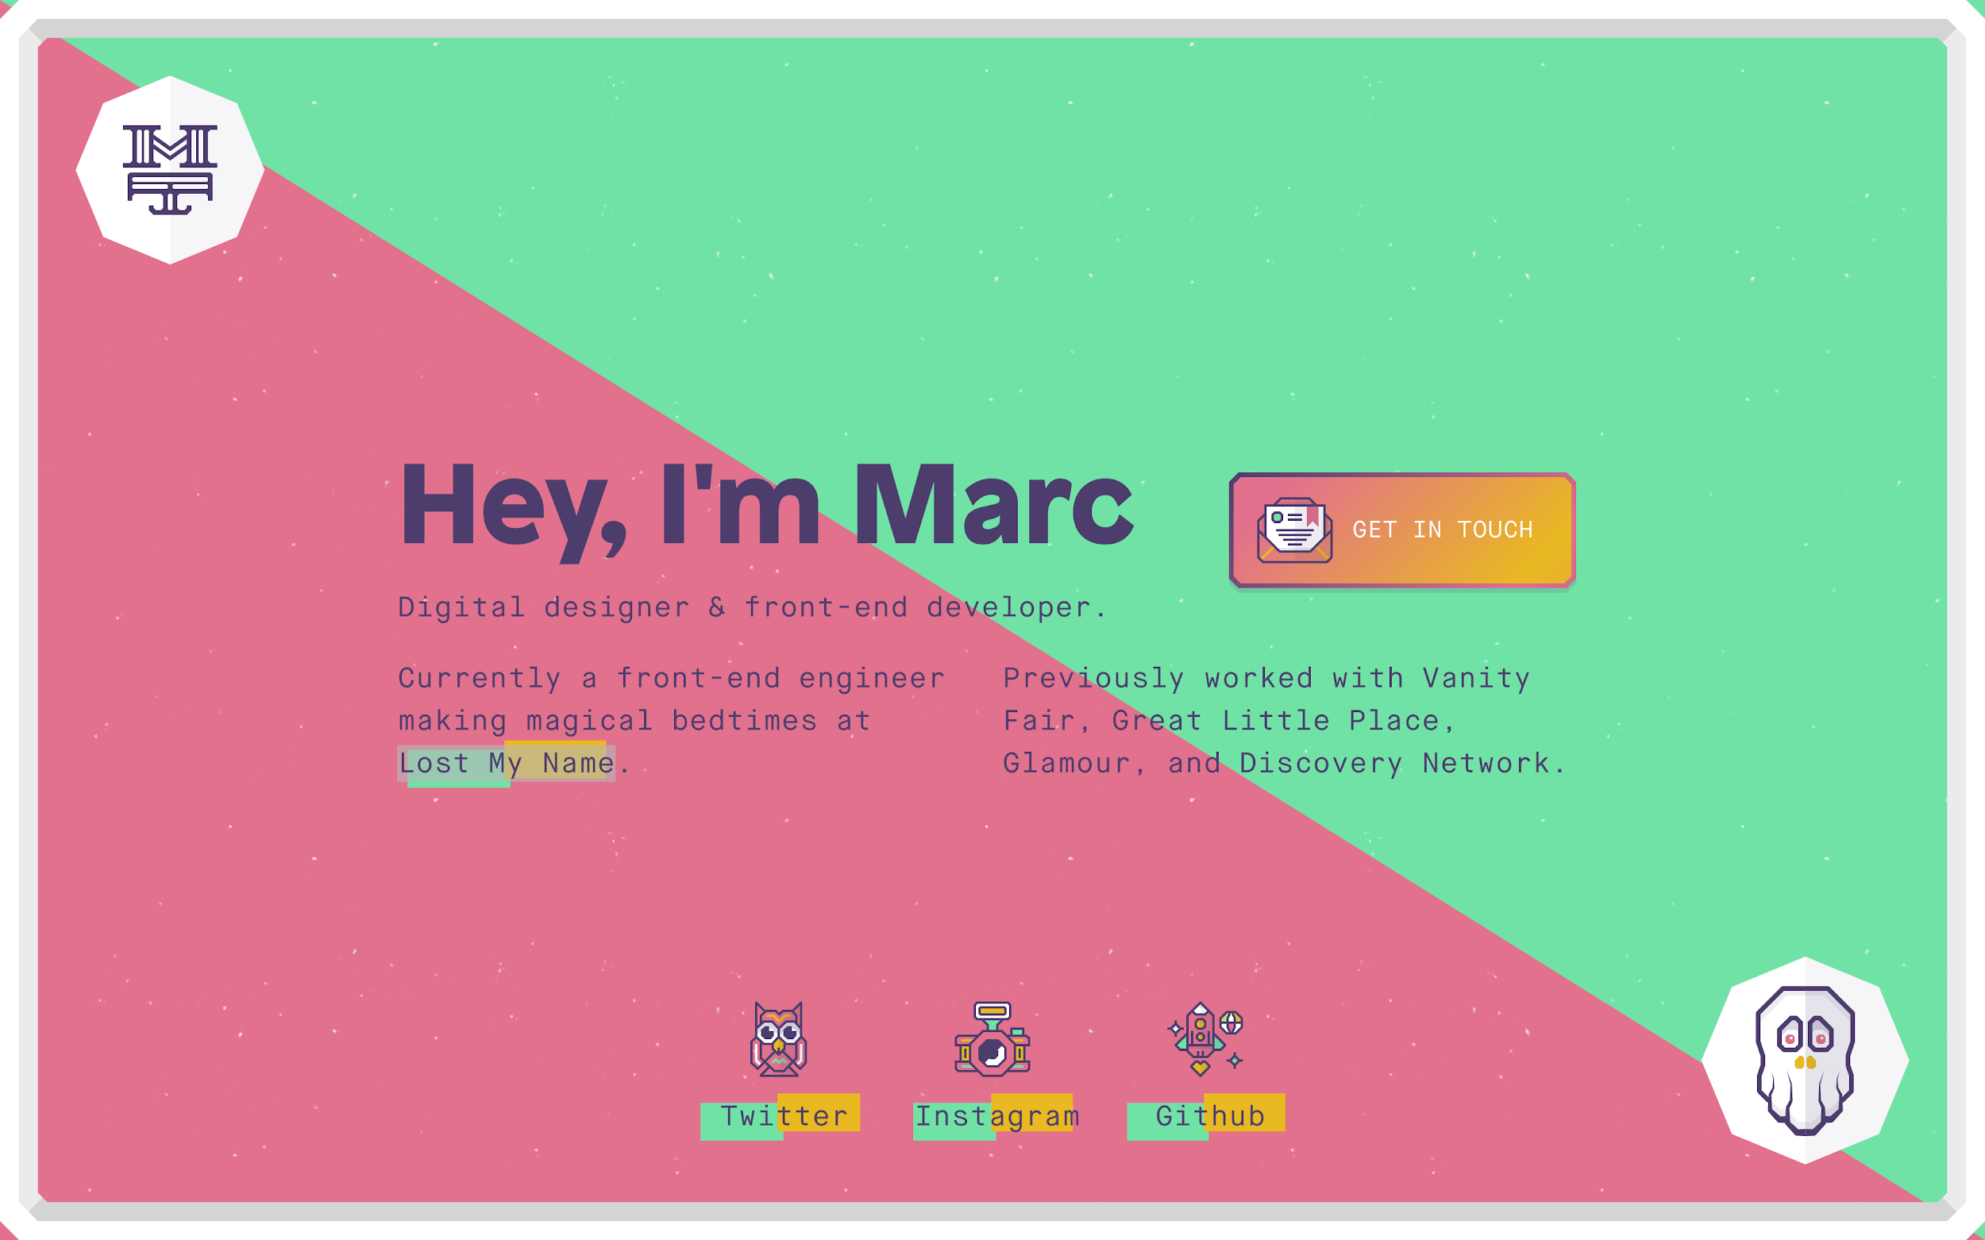
Define your goal
What is your professional goal?
How can your website express that?
Notes:
http://mrcthms.com/

Slide 34
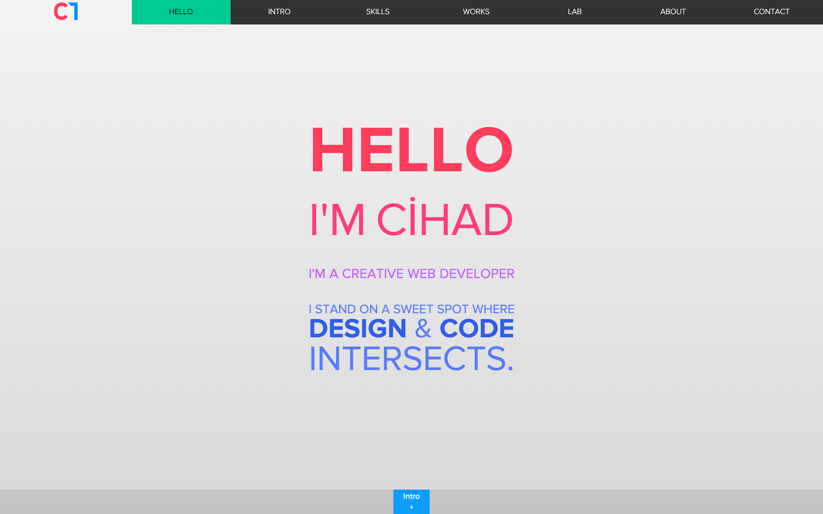
Define your goal
What is your professional goal?
How can your website express that?
Notes:
http://cihadturhan.com/

Slide 35
Define your content
What information should you give to achieve your goal?
Slideshow of work
Featured projects
Contact form
Photo of me
1 paragraph about me
Social Media Links
...etc..
Take some index cards are write this content down! 1 per card.

Slide 36
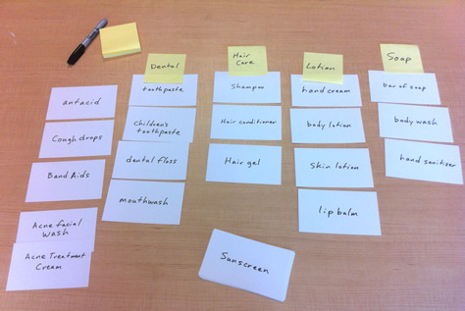
Card Sort
Group your content and start to create pages.
Create new cards for top level pages.

Slide 37
Define your structure
Home
Portfolio
Blog
About
Contact
Tech
Research
Personal

Slide 38
Define your structure
Home
Portfolio
Blog
About
Contact
Two featured projects and images
Three smaller projects and images
Codepens
Tech
Research
Personal

Slide 39
Define your structure
Home
Portfolio
Blog
About
Contact
Featured image of post and short description
6 posts per page
Tech
Research
Personal

Slide 40
Define your structure
Home
Portfolio
Blog
About
Contact
Tech
Title
Date posted
Article
Comments
Sidebar with related posts
Research
Personal

Slide 41
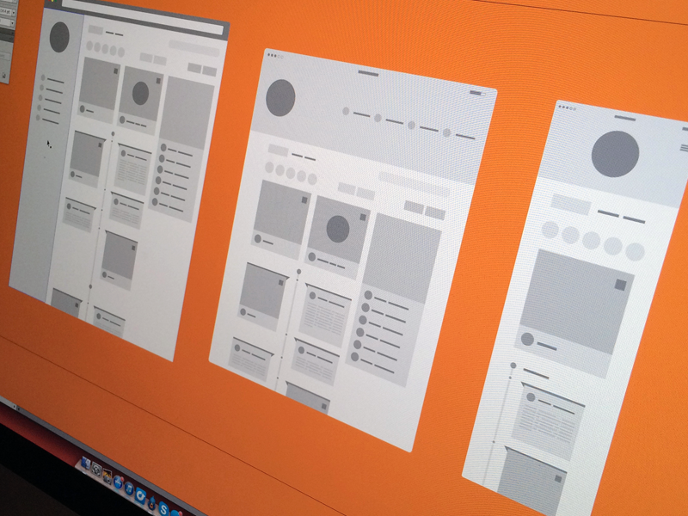
Wireframing
Header
Navigation
Page Content
Comments
Sidebars/Widgets
Footer
Notes:
Header:
This typically contains the logo, the name, and the tagline of the site. It sometimes also includes any or all of the following: search, navigation, advertising, social media links, bread crumbs, login and registration. A successful header will tell the user where they are and what to expect from the site.
Navigation:
Horizontal or vertical? Single level or drop-down/fly-out? WordPress 3 offers a menu system to help you build and define multiple menus where you can define which pages should be displayed in each. You do not have to use it, but the default is to use the function wp_listpages (more on this later) which will list all pages in the menu system. Where you may what legal and/or privacy notice pages to appear in the footer only and not in your main nav. Some people put the main menu in the header, some put it under the header, others put it in the sidebar, or even entirely in the footer.You need to decide which pages show in which menu and how the menu will appear in each part of the page.
Content
WordPress uses what they call "The Loop" to sift through the database and pull out the main content that should be display on the requested page. By default the loop will include post title, the main content, meta data (tags, categories, post date, author), and comments. The default view is title,date and author, content, tags and categories, then comments. You will be able to customize what displays where or if at all.
There are also pagination controls. You can allow your viewer to click to older or newer entries, or see a number line when there are enough entries.
Comments
Some love them, some hate them. If you decide to use them you need to keep a vigilant eye on them. Nothing turns a visitor off like a comment thread full of spam. That said, comments have a fair amount of options as well. Can anyone comment or must they e registered first? Show avatars or not? Show as individual list view or threaded ( allow commenters to comment on other commenters' comments). Often people highlight or slightly change the style of comments that are posted by the author.
Sidebars & Widgets
Wordpress can be a single column design, or two or three columns. But wordpress uses the term 'sidebar' to define a specific column that plugins and widgets can add extra content to. This is where most people list categories/tags, their blogroll, and add in extra features via plugins/widgets like social media feeds/links, advertising,
Footer
Traditionally site footers are a color bar with a few links and copyrights, but lately people have used it as an area to treat their visitors for their continued interest in the site.
The famous WordPress Theme called Hemingway removed the side bar and put all the side bar info into the footer. http://warpspire.com/hemingway/
http://www.smashingmagazine.com/2008/04/08/footers-in-modern-web-design-creative-examples-and-ideas/
http://sixrevisions.com/web_design/25-stylish-website-footer-designs/
http://www.youthedesigner.com/2010/03/29/examples-website-footer-designs/
http://vandelaydesign.com/blog/galleries/blog-footers/

Slide 42
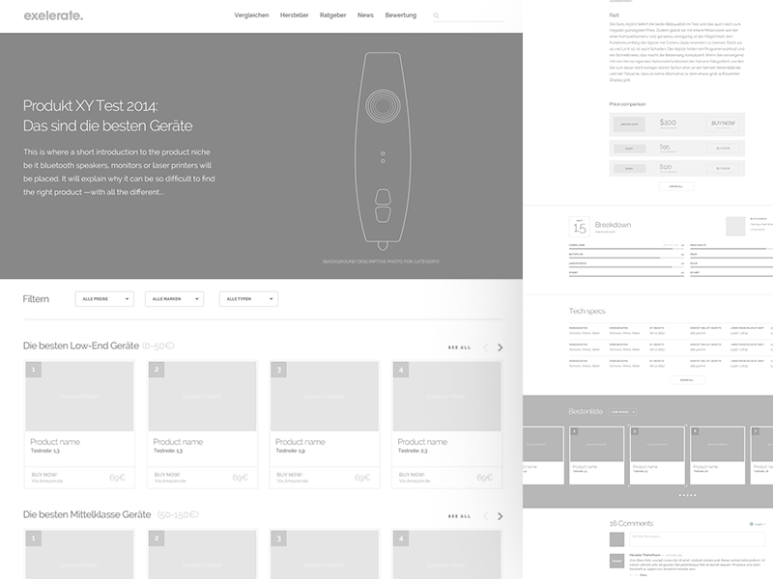
Wireframing
Search Bars
Extra features YOU want
Filtering
Notes:
Search
WP has search functionality built in. Will you use it? Where will you put it?
Extra Features
You might also want to consider Extra features like (but not limited to): Feature Sliders, Custom Page Templates, Advertising and Social Media Links.

Slide 43
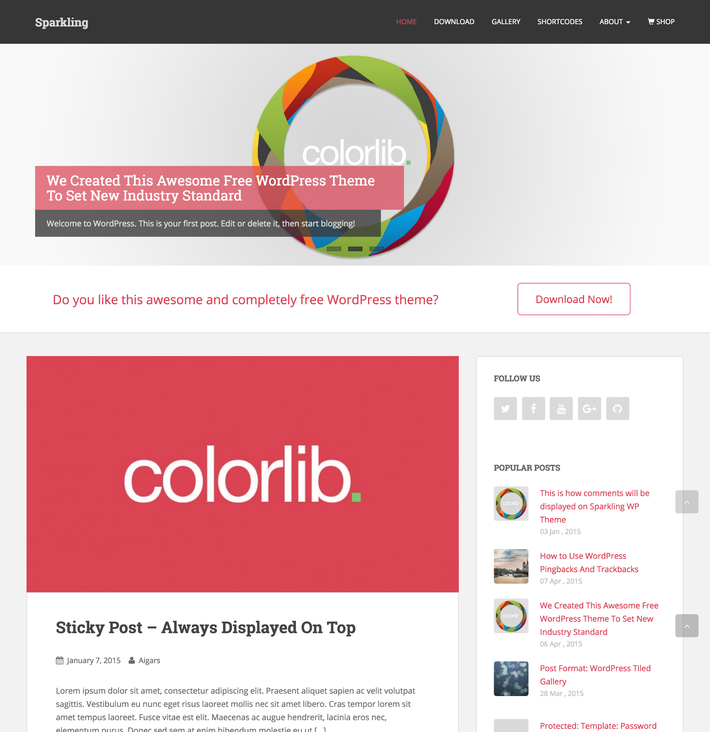
Homepage
Notes:
Home
What will your visitor see when they go to the top level of the site. Here is where you want to show off your best features/work. The design of this page should tie in directly to the message you are trying to send. This sets the tone and structure for all subsequent pages.
https://colorlib.com/sparkling/

Slide 44
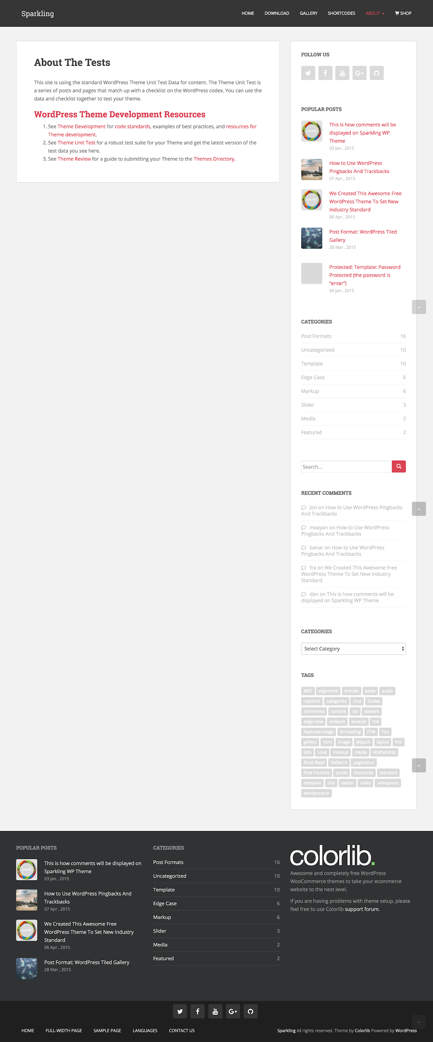
Single Page
Notes:
Single Page
Themes vary on whether or not to show the sidebar on Pages, especially since these are the pages that the menu system links to. It is a possibility to design custom Page templates so that not every Page looks exactly alike.

Slide 45
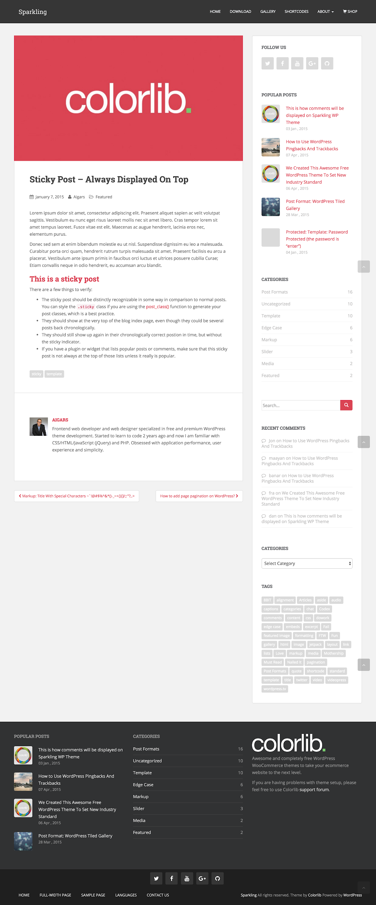
Single Post
Notes:
Single Post
This could contain portfolio entries, blog posts, or both. These are the pages that are defined by tags and categories. Lists of tags and categories usually go in the sidebar to help the view sift through the content. These not only show the Post Title and Content, but also Comments (if enabled) and an extensive list of metadata.

Slide 46
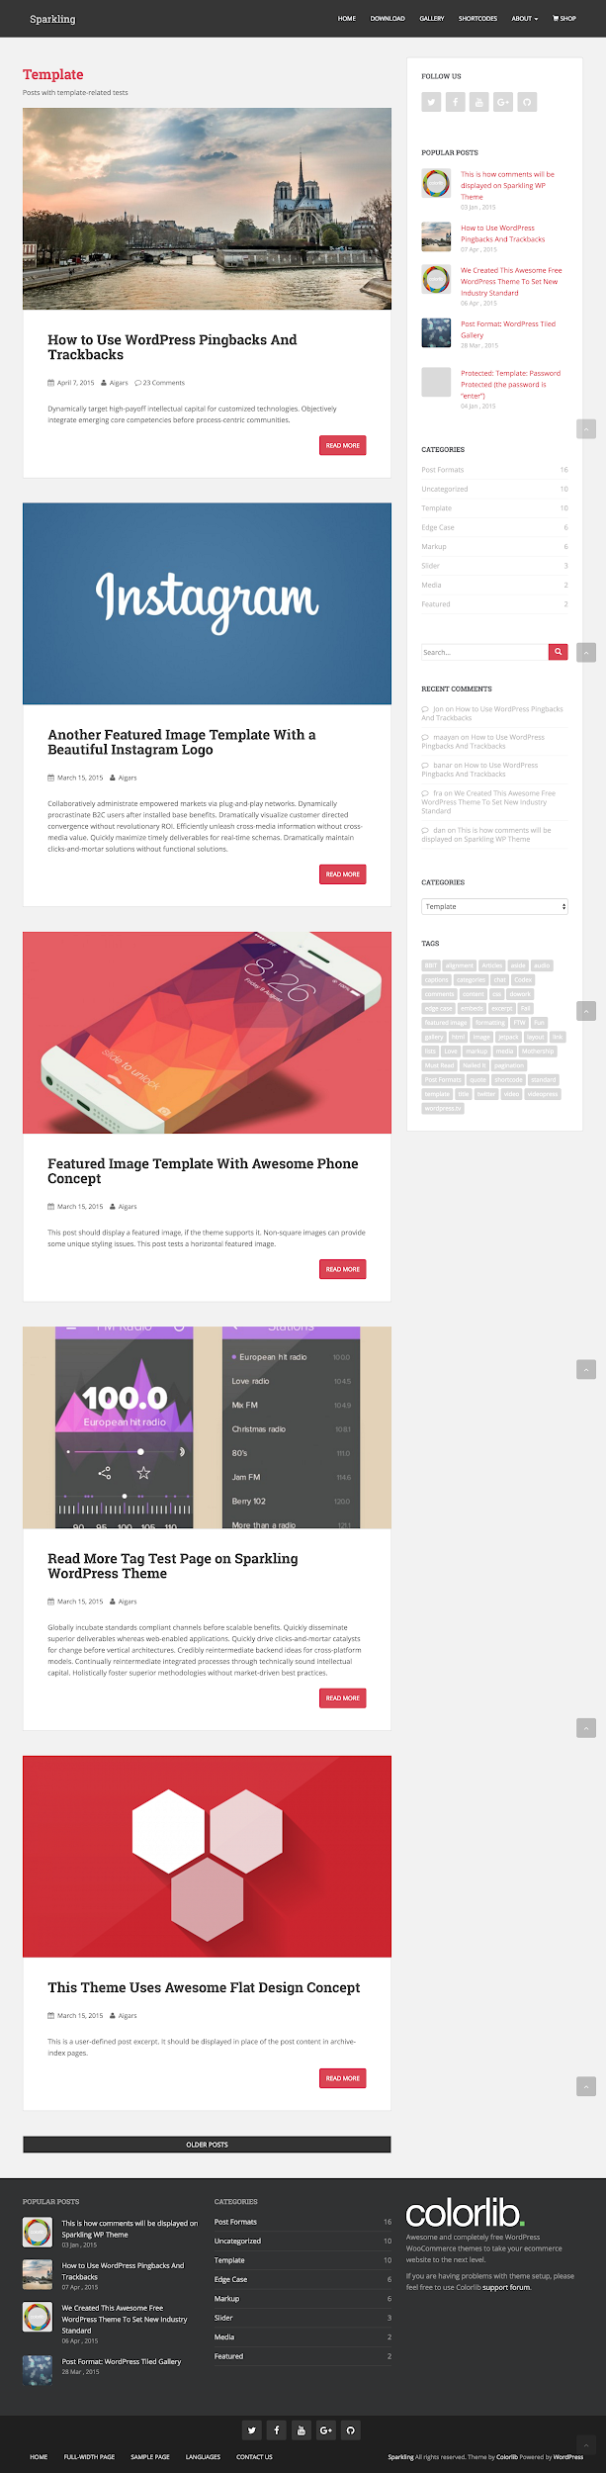
Archive
Notes:
Archive, Author, Category, and Tag pages
You can also allow the user to view lists of Posts that sort out all the Posts that fulfill a specific requirement, such as all Posts with a specific Tag, Category, etc… These usually show a list of Posts including: title, content excerpt, and limited meta.

Slide 47
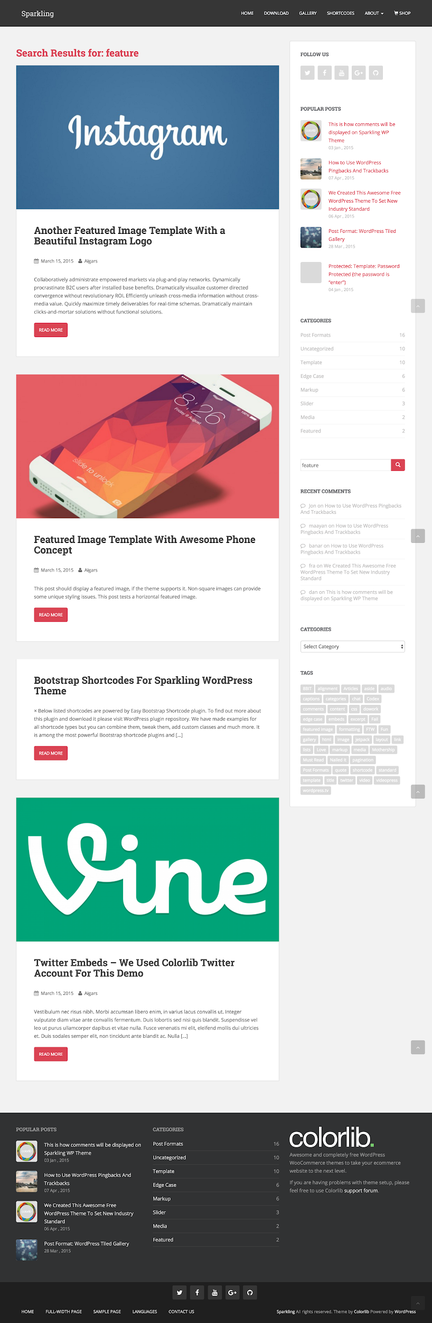
Search
Notes:
Search Results
This page works the same as the archive, author, category and tag pages, but you can fine tune exactly what you want this page to reveal.

Slide 48
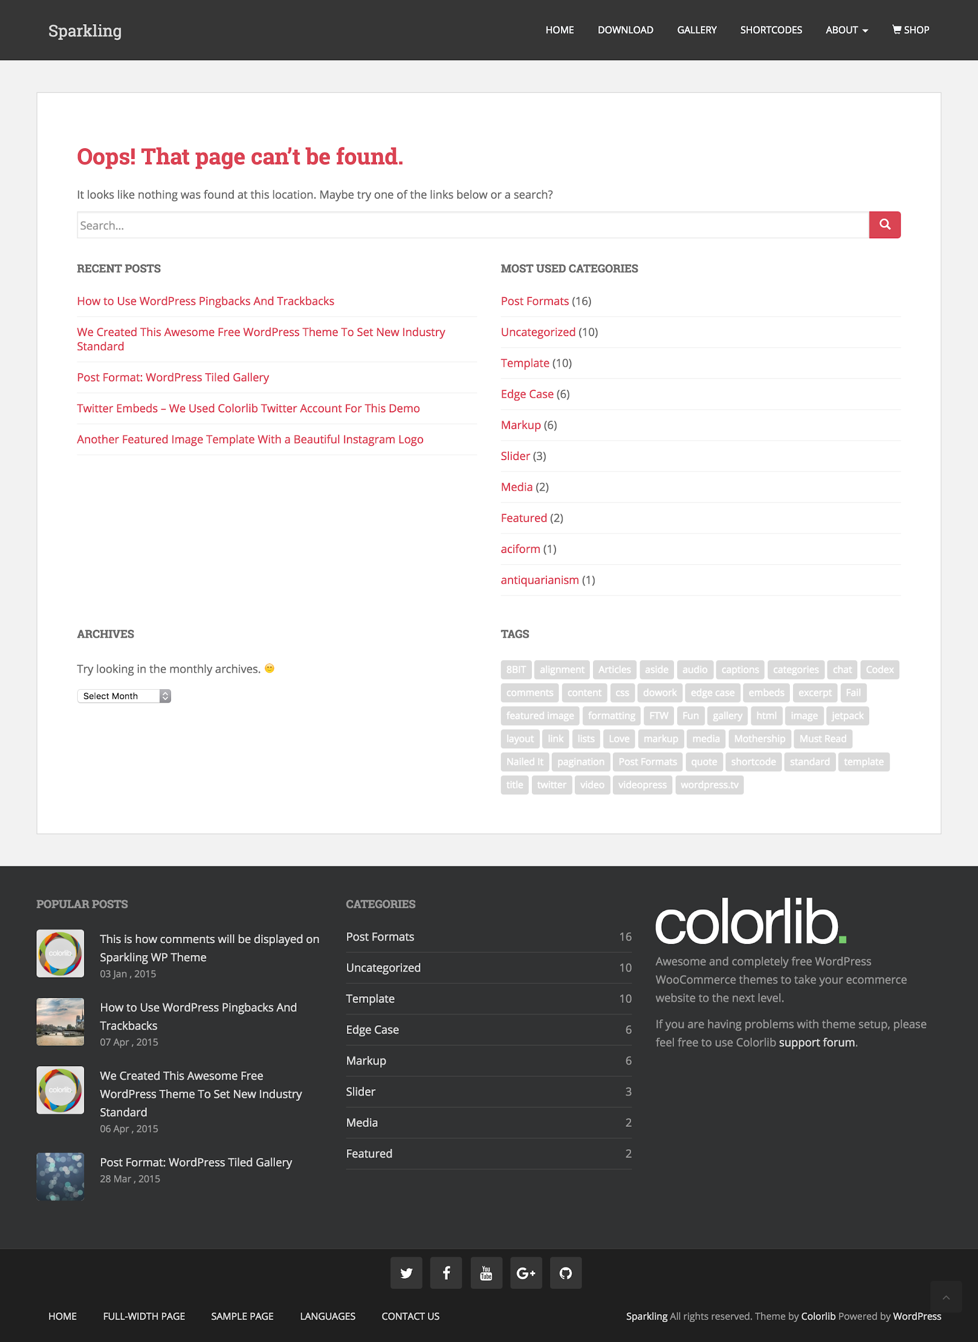
404
Notes:
404
WordPress provides built in "page not found" 404 error handling. Rather than just sending you user back to where they came from or to the home page, it is nice to let them know that there was some sort of error and try to help them find it by including search functionality, a list of tags/categories, latest posts, and most popular posts. Some people have a lot of fun with this.
http://www.smashingmagazine.com/2007/08/17/404-error-pages-reloaded/
http://www.hongkiat.com/blog/60-really-cool-and-creative-error-404-pages/
http://www.tutzone.org/2009/05/31-cool-404-error-page-designs.html

Slide 49
Assignments 01
Notes:
https://learn.dcollege.net

